Slide 1
Epic Games and its Impact with Fortnite
Institution Affiliation
Students’ Name
Date of Presentation

Slide 2
Epic Games and its Impact with Fortnite
It is a video game and software development company located in America, North Carolina, in Carry (Wu & Zhang 2019).
This company develops the Unreal Engine, which is a game engine used to develop video games like the Fortnite, Gears of War, Infinite Blade, and the Unreal.
Fortnite is an online video game that was developed by Epic Games Company. It has three different modes of games that share the same game engine.
They are; Fortnite Save the World, Fortnite Battle Royale, and Fortnite Creative.

Slide 3
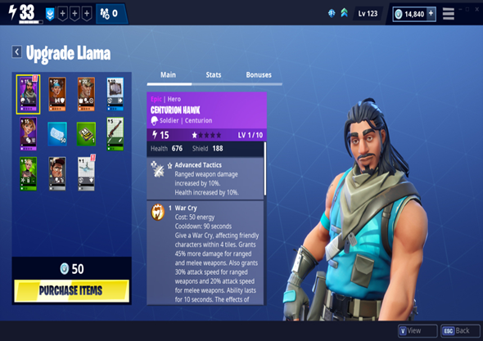
Conti..
Source: https://pmcvariety.files.wordpress.com/2019/01/loot-boxes.jpg?w=1000&h=563&crop=1

Slide 4
Cont..
For the recent years, Fortnite has traumatized the gaming industry by projecting itself into a tremendous socio-cultural setting.
Its popularity has created questions about the future of other top video game companies like Take-Two Interactive and Electronic Arts (EA) because of the stiff completion.
Epic Games is a monopolistic competition market (Joseph 2018). Firms are free to get into the market, and there are many consumers and firms in the market.
It is a privately owned enterprise that was founded by an American Tim Sweeney. They provide gaming services to their clients.

Slide 5
Cont..
They own video game developers such as Chair Entertainment and Psyonix. They also have Cloudgine, a cloud-based software developer.
Their gaming services are available publicly, and anyone in the World is free to access.
Epic Games is a video game industry that operates other eponymous sub-studios located in England, Seattle, Berlin, Seoul, and Yokohama.
According to Iqbal (2019), Epic Games was valued at $15 billion in October 2018, up from $8 billion in July the same year. This was a 47 % increase in six months.

Slide 6
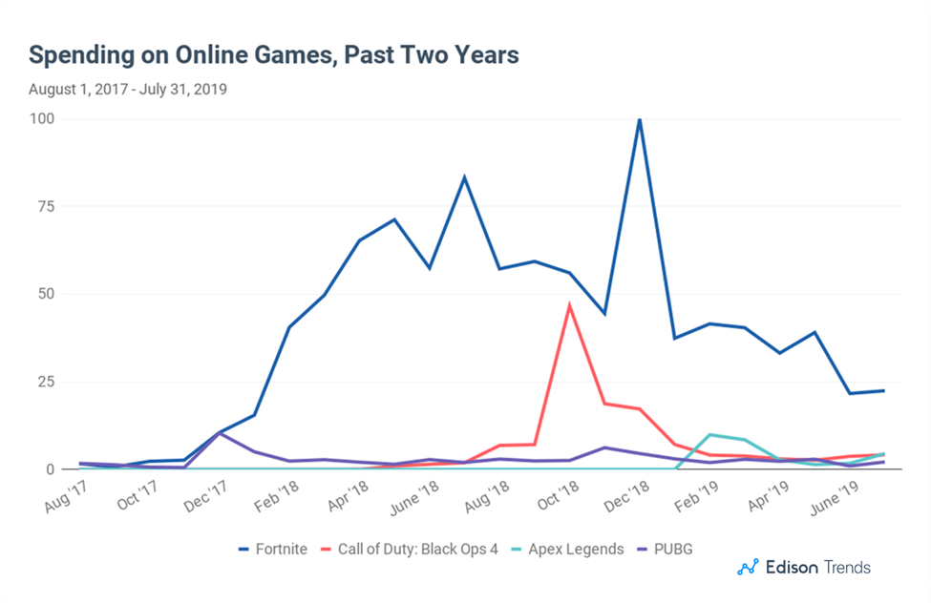
Cont..
According to analytics firm SuperData, Fortnite 2018 revenue amounted to $2.4 billion, which was the highest yearly revenue figure in gaming history by its reckoning. This was an increase of 11% in total gaming revenue over 2017, which was a total of $109.8 billion (Iqbal 2019).
The graph below shows Fornite revenue vs. other online games from Aug 2017 to July 2019.
Source: https://1z1euk35x7oy36s8we4dr6lo-wpengine.netdna-ssl.com/wp-content/uploads/2018/11/fornite-spending-increase-and-decrease.png

Slide 7
Cont..
Wu & Zhang (2019) said that Epic Games was founded by an American Tim Sweeney, who is the owner with the most significant shares.
Other shareholders that support the company include; Tencent, with almost 40 % of the company's value and Mark Rein, who is the company's president.
Their platform containing their games are open and open to access worldwide.
They develop video games and other services such as software development using Cloudgine.

Slide 8
Cont..
This company uses social media platforms such as Twitter, Facebook, YouTube, and other websites to advertise their games.
They use the most influential game like Fortnite, to attract the attention of their players.
This is a sales technique as most of the people will be attracted and subscribe to their games (Wu & Zhang 2019).

Slide 9
Cont..
They respond effectively to the complaints of their customers through their website as well as developing games needed by their customers.
The company's strategy is useful as it is a monopolistic market structure. There are many firms, as well as customers.
A good sales and marketing strategy used by the Epic Games has made it emerge as the best platform that develops video games.

Slide 10
References
Iqbal. M. (2019). Article about "Fortnite Usage and Revenue Statistics (2019)”. Updated 2019. https://www.businessofapps.com/data/fortnite-statistics/. Retrieved. 2019.
Joseph C. T. (2018). Article about "Market Structure and Trend Chasing in the Video Games Industry." Updated 2018. https://medium.com/@jclement2009/market-structure-and-trend-chasing-in-the-video-games-industry-ef62dde3d541. Retrieved 2019.
Todd, S. (2019). Article about “Fortnite Goes Dark: A Masterful Marketing Stroke by Epic Games." Updated: 2019. https://variety.com/2019/digital/news/fortnite-dark-epic-games-marketing-stroke-1203369504/. Retrieved. 2019.
Wu, A., & Zhang, C. (2019). Epic Games. Revised in 2019. https://www.hbs.edu/faculty/Pages/item.aspx?num=55889. Retrieved. 2019.

